Slide 1


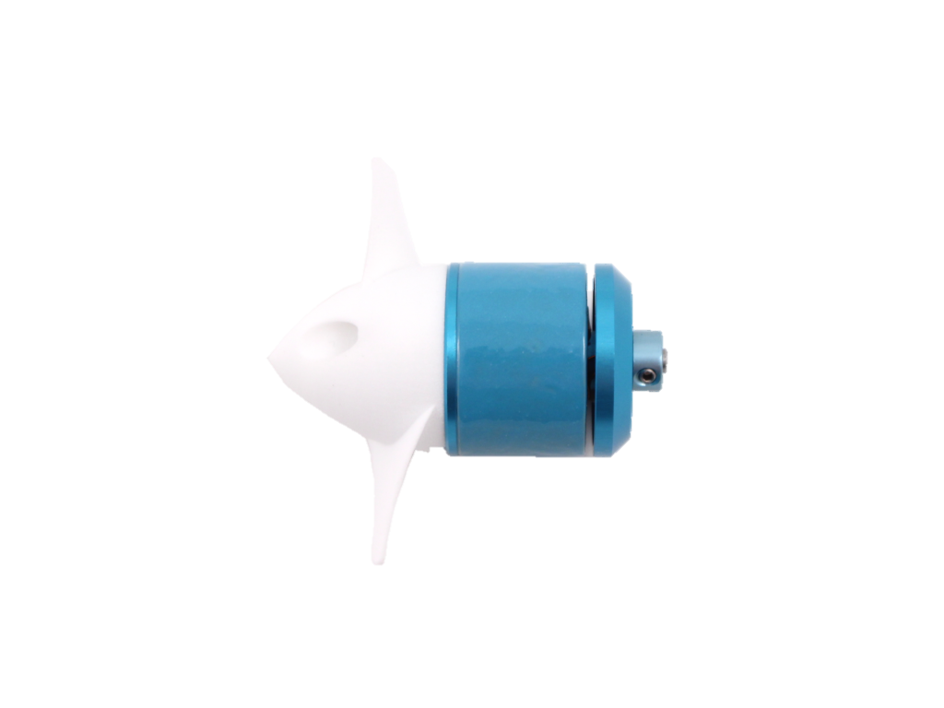
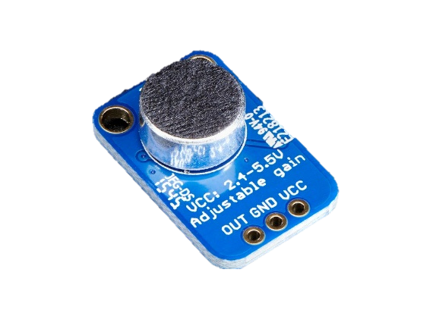
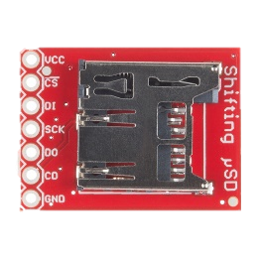
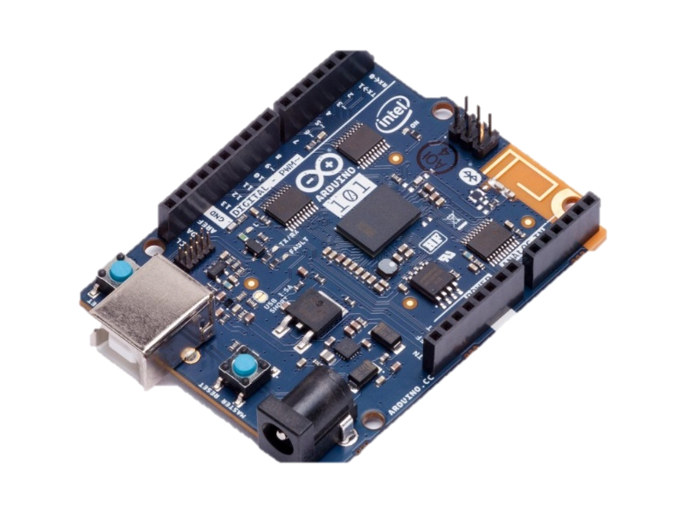
Developing swimming in pipe robot
Student: Ziqi Wang, Electrical Engineering (computer), University of Sydney
Director: Dr. Stevan Dubljevic, Department of Chemical and Material Engineering, University of Alberta
Introduction
Design
Every day, pipeline leakage causes a large amount of water (or oil, gas,etc.) lost. The old way to detect the pipeline leakage always consume a lot of times and human resources.
It is in need to have an new leakage detection way to offer help. SwimBot is designed for low-cost, constantly-running leakage detection.
Hardware
Arduino 101 microcontroller ($30.00)
This board has low power consumption of inter curie module with an IMU and a Bluetooth unit inside. There are 14 output/input pins on this board, which can provide enough interface for this project.
Microphone ($6.49)
Maxim MAX4466 is an op-amp specifically designed for a delicate task which can recorded 20-20KHZ electret sounds. This microphone is very suitable for detecting varieties size of leaking.
MicroSD Shied ($4.95)
Using MicroSD card to minimize the size of the core part and also use it to load IMU data and Microphone data.
M100 Brushless Motor with propeller ($82.00)
This motor is a rugged brushless motor for use in the ocean and in extreme environments. This propeller with M100 motor can generates about 3.2 lb of forward thrust and 2.6 ln of reverse thrust.
Speed controller ($25.00)
This controller is based on the BLHeli_S ESC design, providing an speed control and voltage adjustment for Motors.
Outfit
Using 3D printer to print a special outer casing or shell for this swimming robot. The whole device is designed like a bullet so it can reduce the force of water. There is a gap surrounding the chips so it can isolate water from chips.
Methods
Hardware control:
Begin
Power?
NO
YES
NO
(LED1 on & 2 off)
Motor & MicroSD
& IMU Setup?
YES (LED1 & 2 off)
LED1 & 2 on for 3S
Start Motor
3D model of swimrobot
Software
IMU
IMU (Inertial measurement unit) is an electronic device that measures and reports a body‘s specific force and angular rate, using a combination of accelerometer and gyroscope.
Big Data Analysis
To detect the leak with sound data, we should find ways to tell apart the difference between normal sound signals and the ones at leak points.
Once we get the raw data of the sound from the microphone, we should first identify the feature vector of the sound. Then, we use machine learning methods to classify leak and non-leak situations.
Read data from
IMU & Microphnoe
NO
Read data string
A =100 times?
A = 0
YES
Conclusions
Further Study
Writing data into
SD card?
YES
Power consumption
The motor consumes a lot of energies, a 600mAh battery can only support for 30 minis as the motor is running at a maximum speed.
Motor
This type of motor is perfect for small devices which require going deep into the water. This motor also provides adjustable forward and backward thrust. This force can be used to break the clogging pipes.
Data processing
There is some conflict between IO interfaces, which causes the unstable of data collection. The time used in writing data into SD card when getting 100 groups of data, may cause lost one or two groups of data. However, the influence to the position detection can be eliminated.
Try to using FPGA to building an stable version of swimming robot, Which will reduce the conflict between IO ports.
Using machine learning to calculate the position of the swimming robot, like to calculate the rest state of the ball.
Adding some universal wheels into the outfit of the swimrobot in order to make it turn more flexibly in the pipe line.
More functions can be added into the swimrobot, such as, a press sensor in front can detect the clogging point of the pipe.
Changing the design of swimrobot, make it more convenient to insert or pull out sd card.
NO
Stop Motor
LED1 & 2 on
Finish
Position Detection
Using the IMU built in the Arduino 101 board, which include 3-axis gyroscope and 3-axis accelerometer, to detect the position.
Writing data as a format of the number, time, microphone, 3-axis gyroscope and 3-axis accelerometer into sd card.
Using outside Matlab function to analyzing the data we load in SD card to get the position of leaking. and also use machine learning to simulate the size of leaking
Team Member
Azzam Hazim, University of Alberta
Junyao Xie, University of Alberta
Kimmy , University of Alberta

